Slide 1

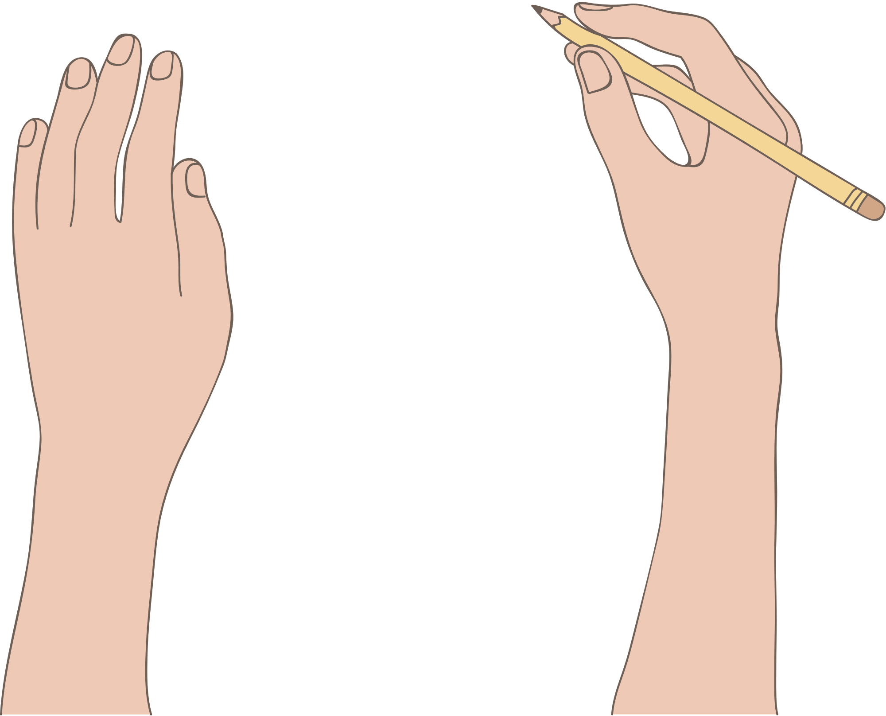

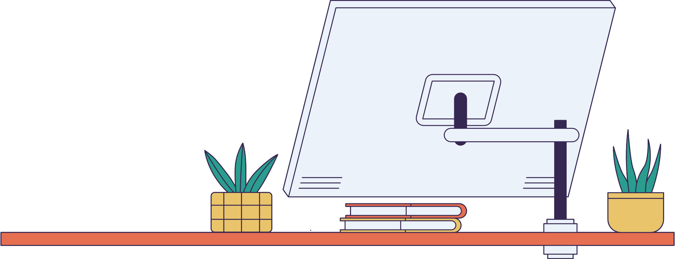
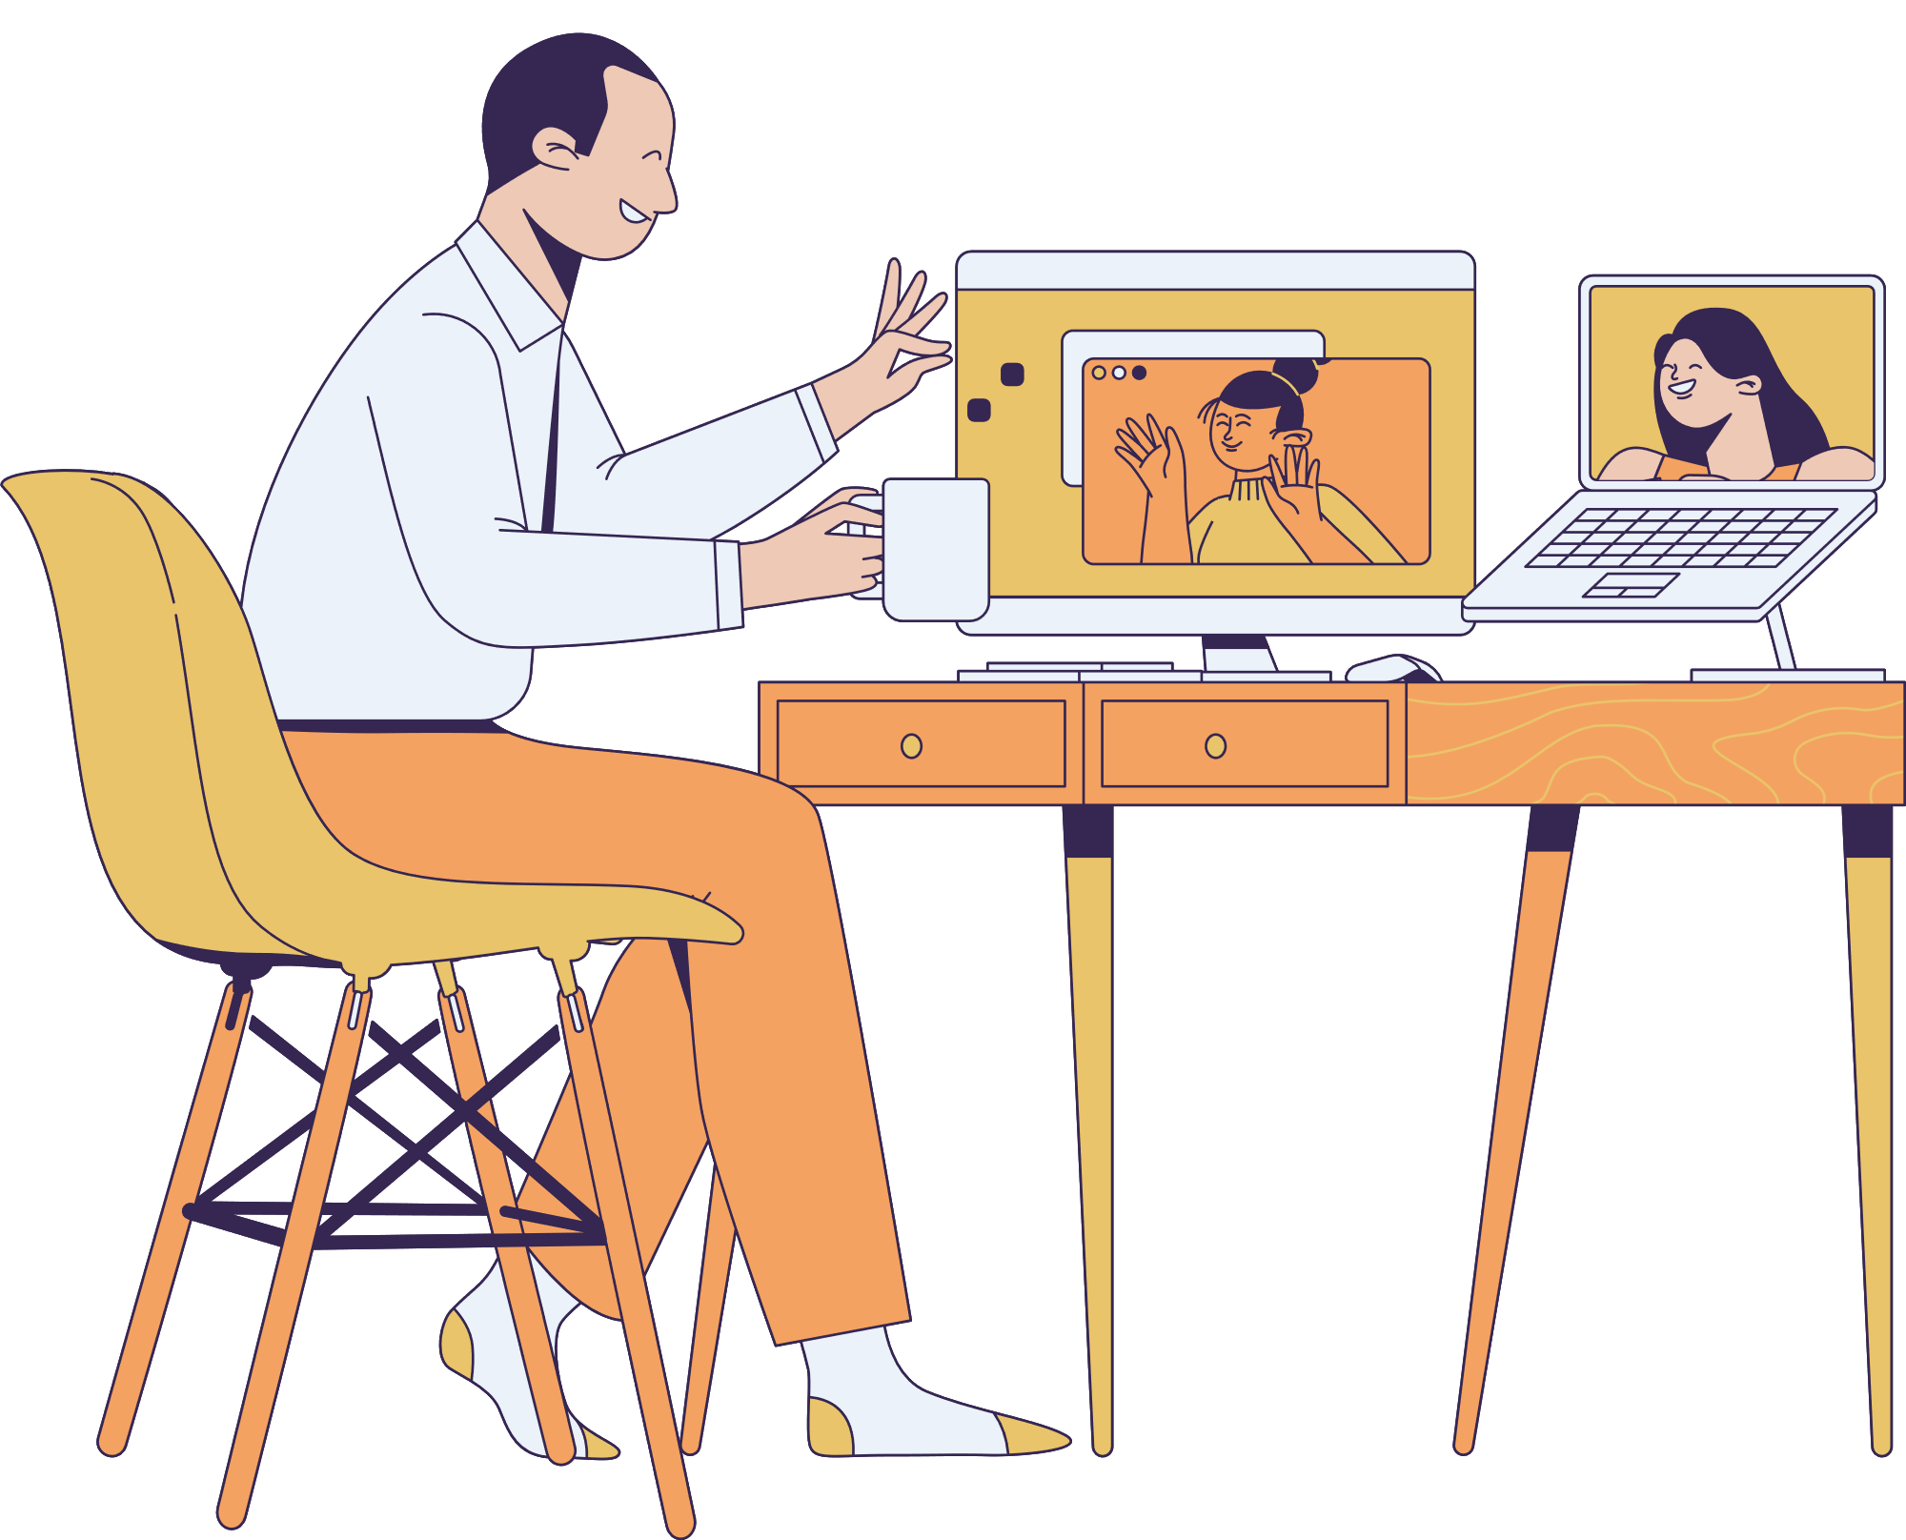



WELCOME TO MY STORY

Slide 2
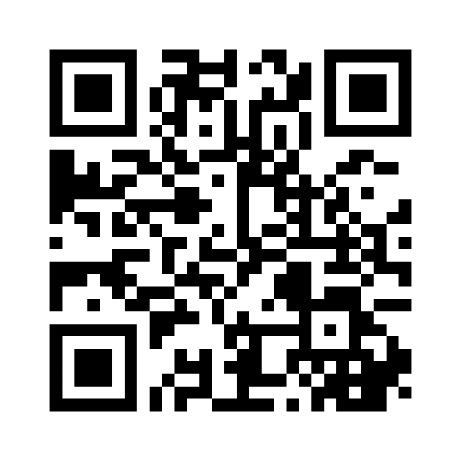
https://forms.gle/1tXWSLArjiNEhpfy7

Slide 3


I always wanted to be a detective from my childhood.
I like to find out things.

Slide 4
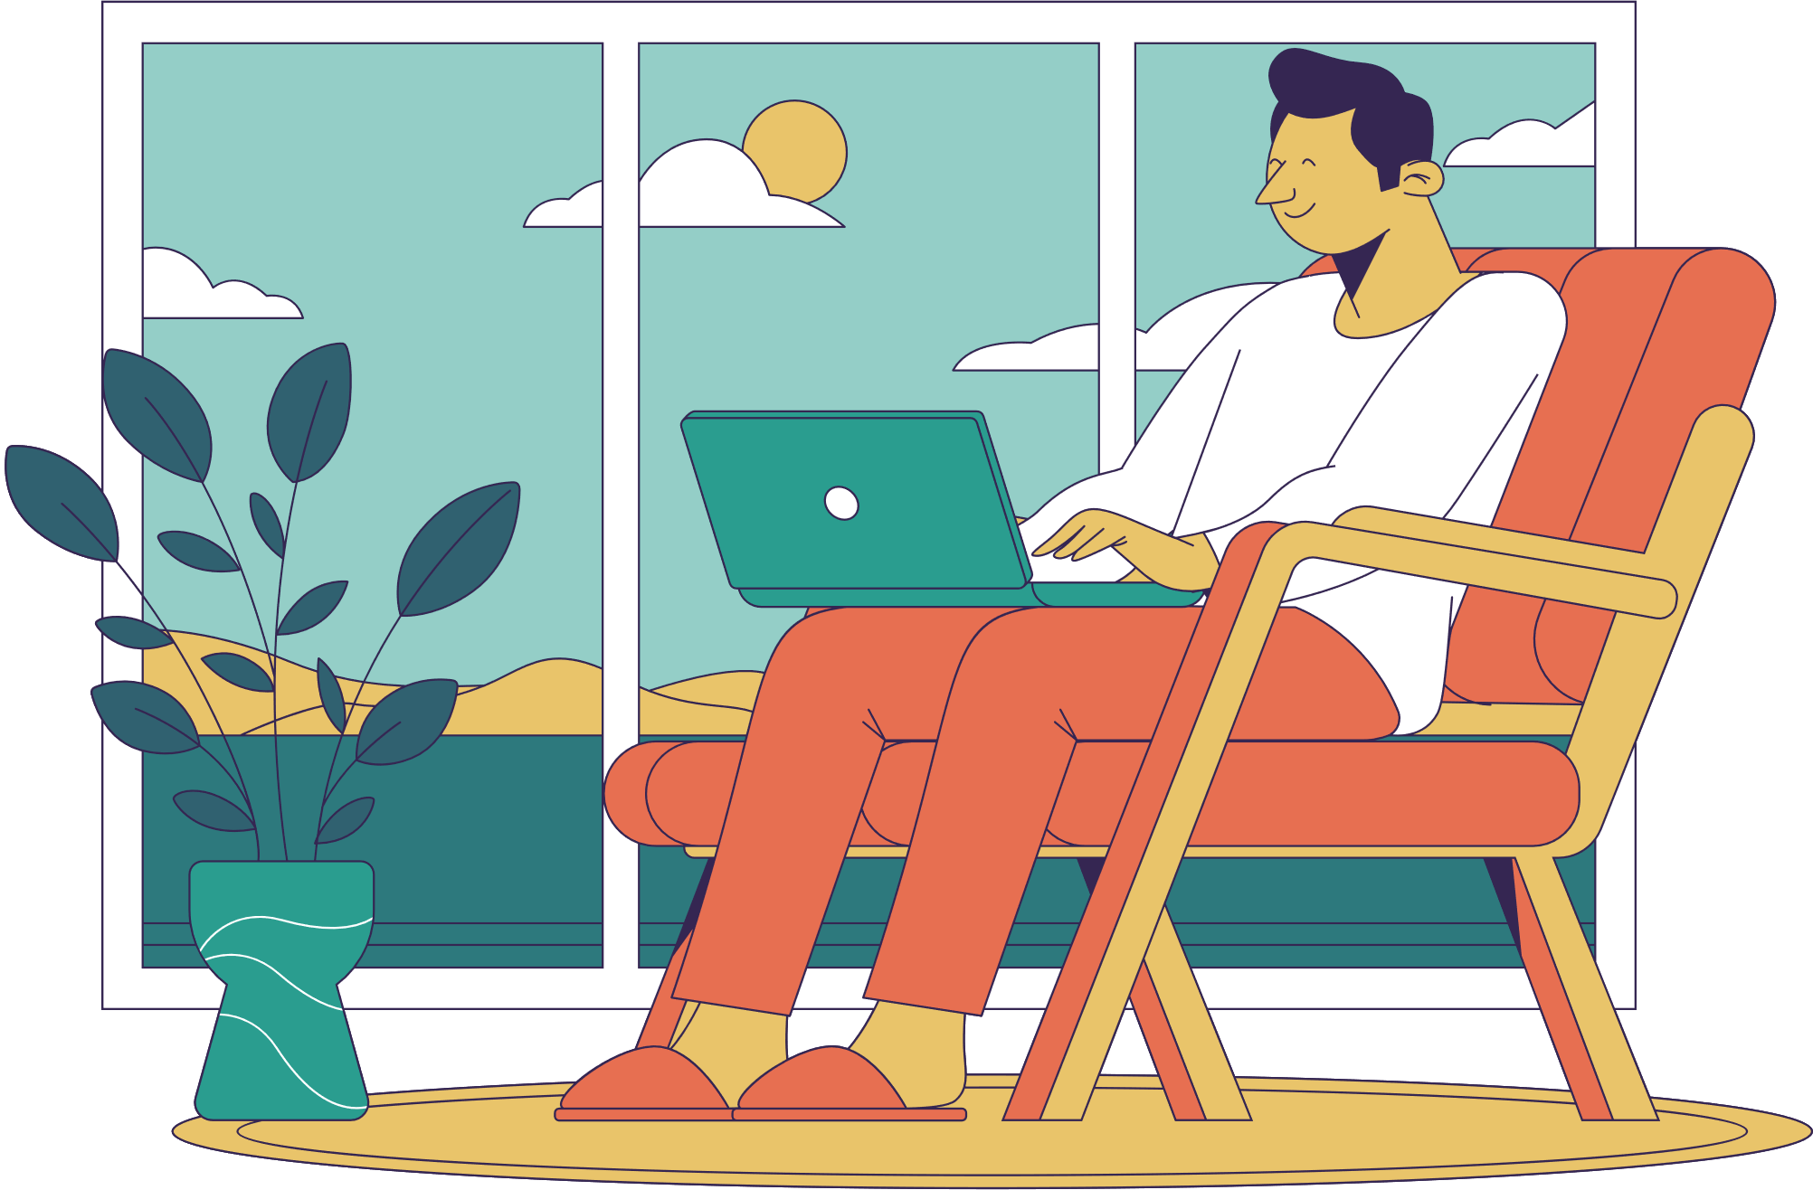
This detective wants to ask some questions
Do you enjoy using your social media?
Have you watched your favourite movie on Netflix?
Have you shopped your favourite stuff from amazon?

Slide 5
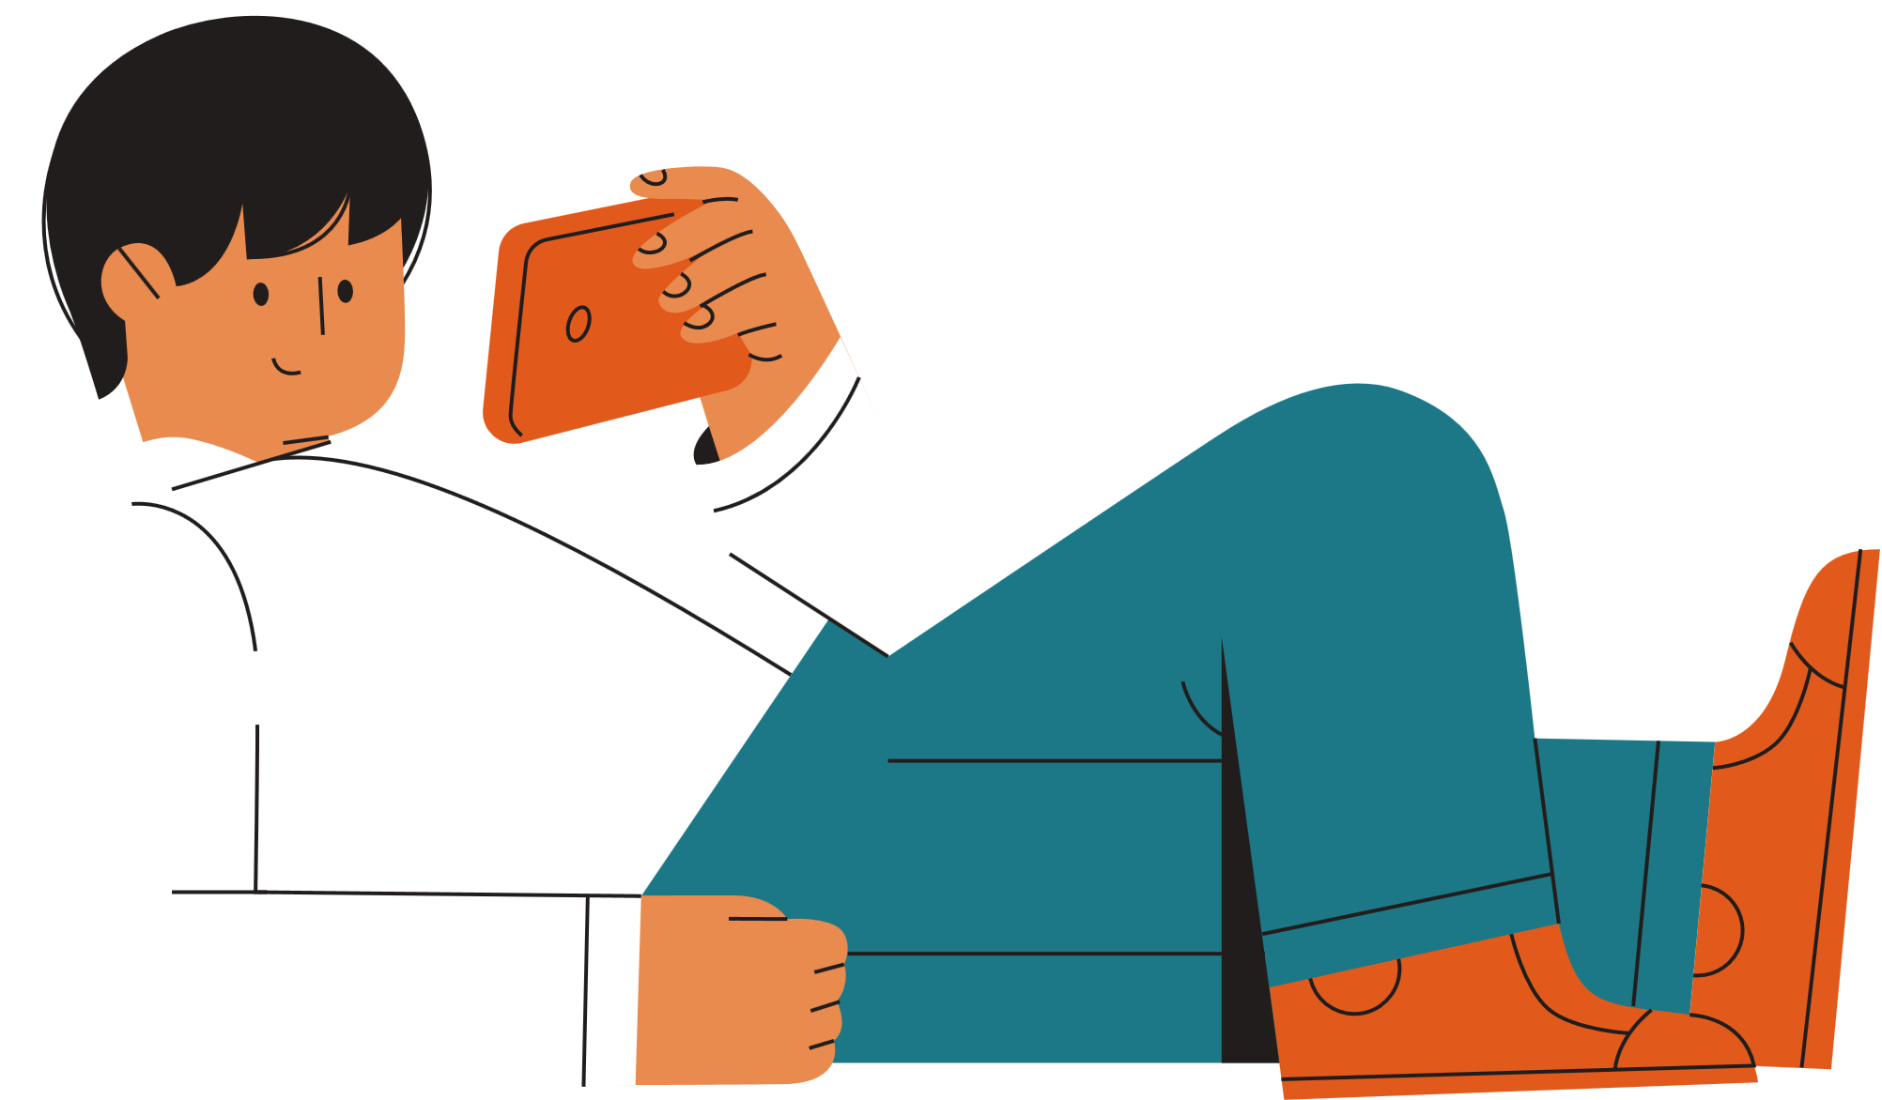
But have you ever noticed what is common in all of them?
Well, I found out something.......
Let me tell you

Slide 6

They all serve us with our interest of content.
But how do these companies know, what I like?
Let me reveal the secret...

Slide 7
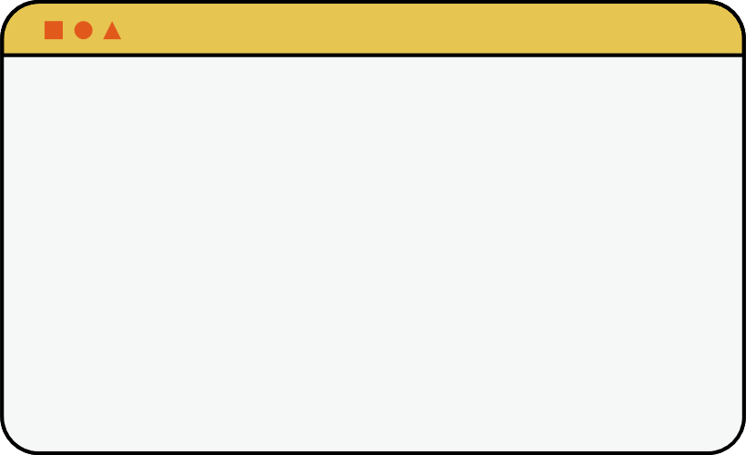

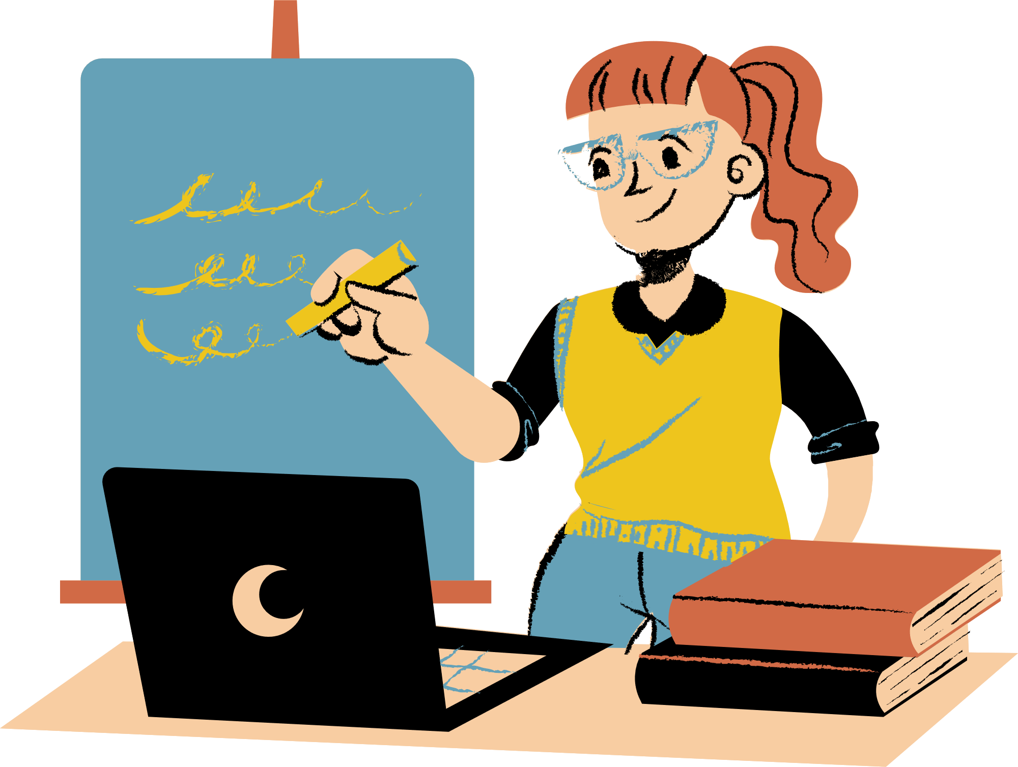
THE SECRET...
These companies use your past data to predict your future behaviour.
But, Who does this magic?

Slide 8

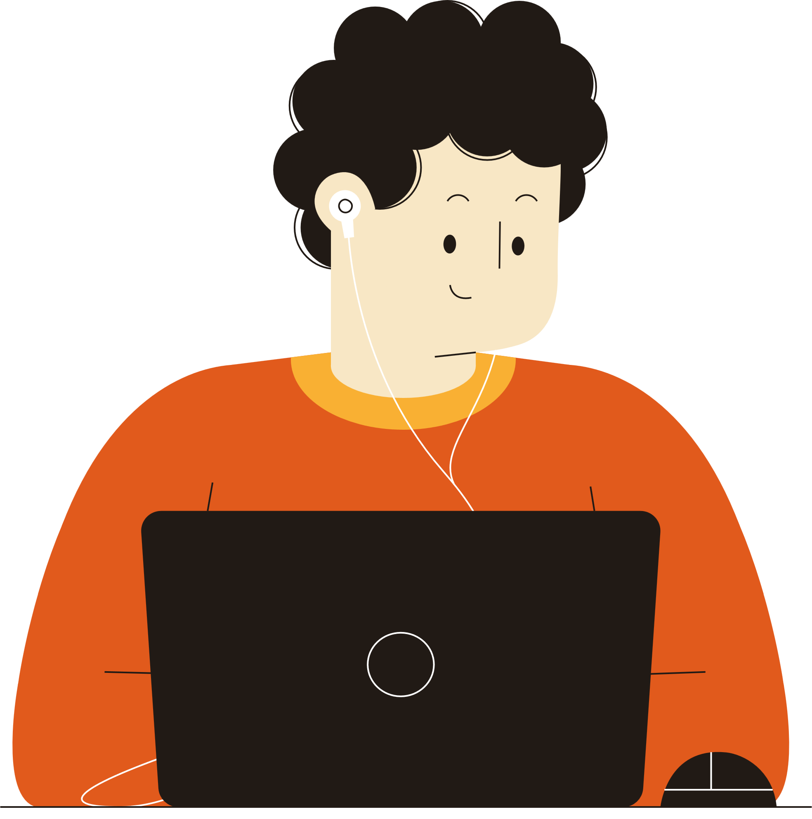
So, gathering your data, processing it and make prediction is done by a magician called data scientist

Slide 9


DON'T YOU WANT TO BE THAT MAGICIAN?

